Slide 1

Introduction to MongoDB and SQL
MongoDB is a leading NoSQL database that diverges from the traditional relational database management systems. MongoDB embraces a document-oriented model, storing data in JSON-like documents within collections. MongoDB's emphasis on scalability, flexibility, and efficient handling of unstructured data positions
Structured Query Language(SQL) is the foundation of relational database management systems. SQL is a domain –specific language used in programming and designed for managing data held in a relational database management system. SQL is developed for managing and manipulating structured data.

Slide 2
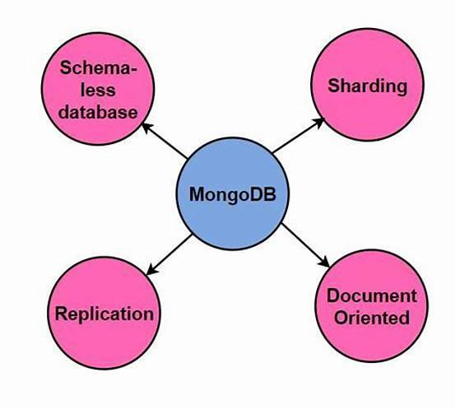
MONGODB FEATURES
MongoDB is
Document-Oriented: MongoDB stores data in flexible, JSON-like documents.
Schema-less: Documents in MongoDB collections can have varying structures.
Scalability: MongoDB is horizontally scalable, allowing for distributed and large-scale databases.
No Joins: MongoDB uses embedded documents and arrays to represent relationships.

Slide 3
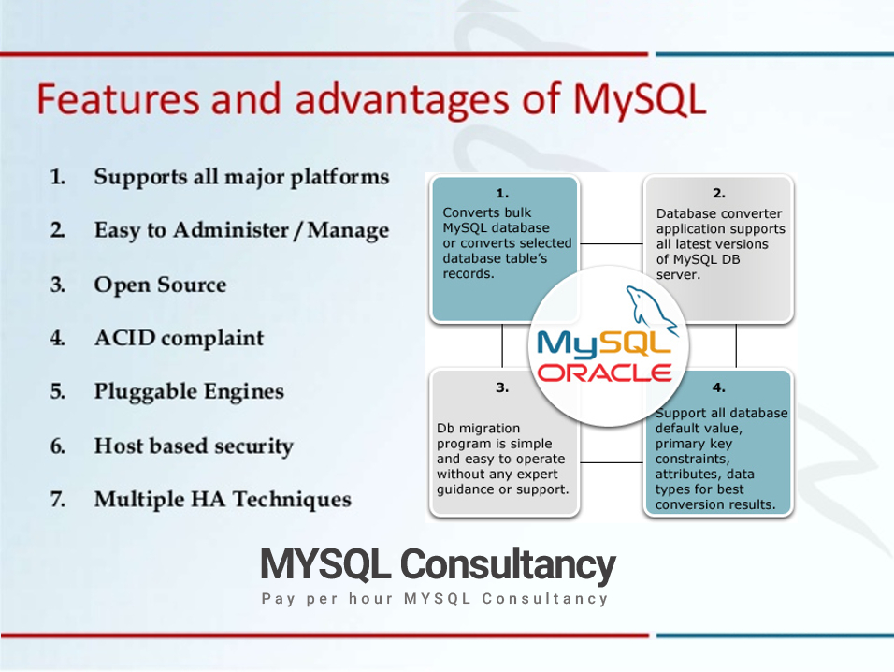

SQL FEATURES
SQL is
Table Structure: SQL databases store data in structured tables with predefined schemas.
ACID Compliance: SQL databases ensure atomicity, consistency, isolation, and durability.
Powerful Queries: SQL supports complex queries using JOIN operations.
Relationships: SQL databases establish relationships between tables using foreign keys.

Slide 4
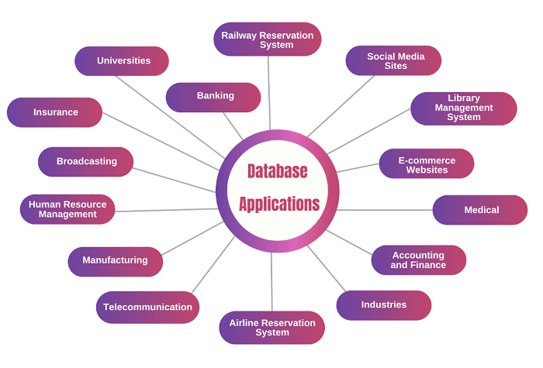
USE CASES: MONGODB AND SQL
MongoDB
Well-suited for applications with dynamic and evolving schemas,
real-time applications,
and projects requiring high scalability.
Structured Query Language(SQL)
Ideal for projects with fixed schemas,
complex queries,
and the need for strong consistency.

Slide 5
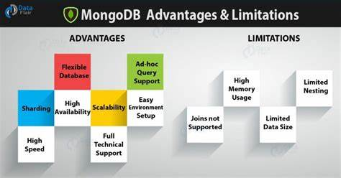
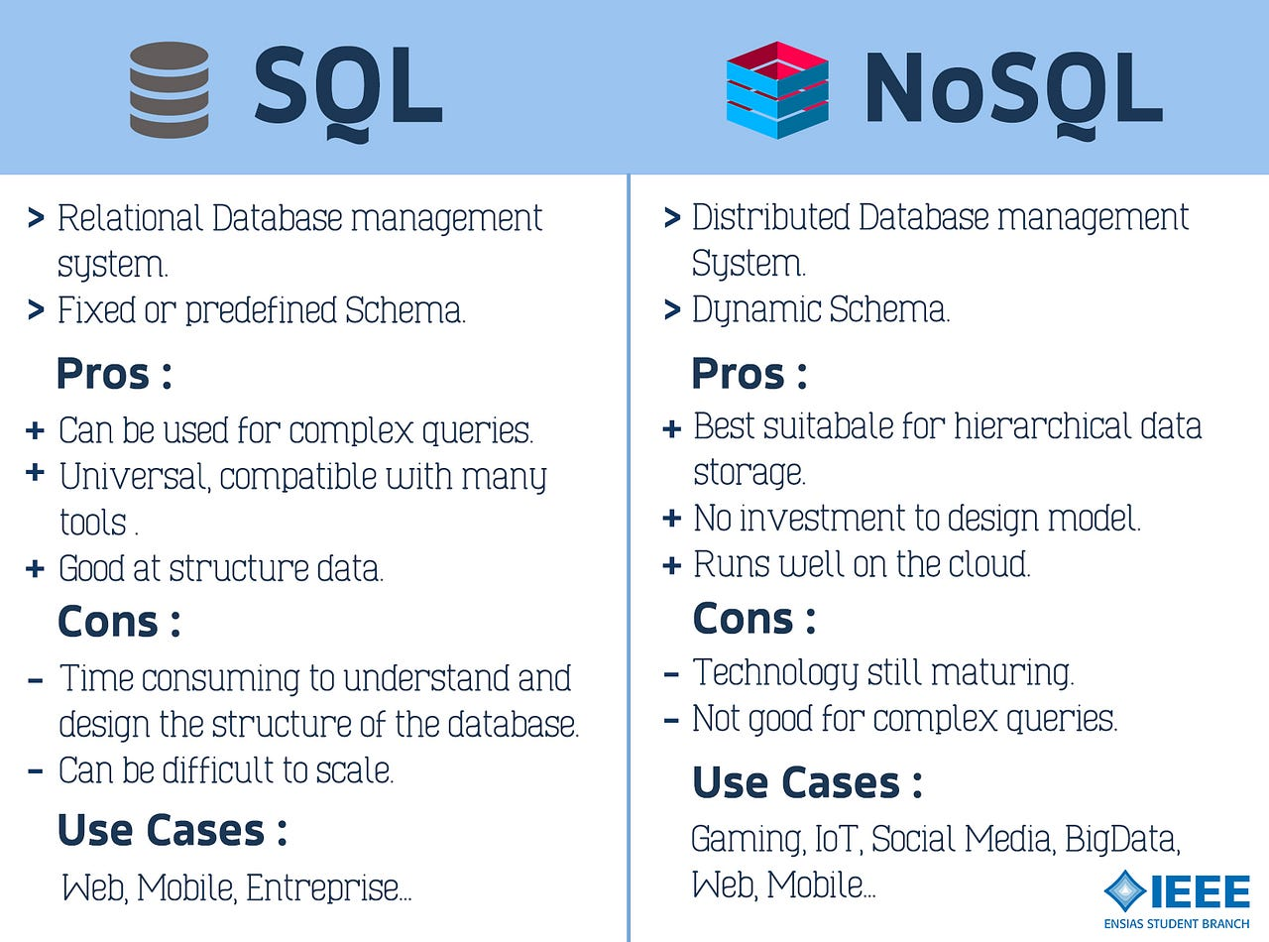
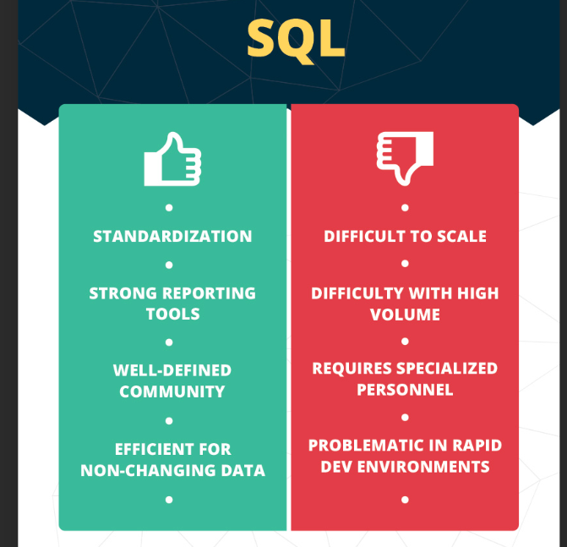
PROS AND CONS OF MongoDB and SQL
MongoDB
Pros: Flexible schema, scalability, efficient for read and write operations.
Cons: May not be suitable for complex transactions or applications requiring strong ACID compliance.
Structured Query Language(SQL)
Pros: ACID compliance, structured data, powerful queries.
Cons: Fixed schema, scalability challenges in some scenarios.

